Slide 1


B.SC. FINAL PROJECT · DIGITAL MEDICAL TECHNOLOGIES · HIT
Predicting Infections during hospitalization among postsurgical patients
A multimodal ML + NLP framework for early infection risk
Tal Meillet
Hodaya Yasayev Klenter
&
I.D. 209966019
I.D. 323856757
Academic supervisors: Dr. Ayelet Butman · Dr. Revital Marbel
Clinical supervisor: Dr. Manor Shpriz- Assuta Ramat HaHayal

Slide 2
CLINICAL BACKGROUND
Hospital-acquired infection: the clinical problem
2-5%
3.5-10B$
0
of operations develop a surgical-site infection - the most common hospital-acquired infection in surgical patients^{[1]}
excess annual cost from SSIs in the US alone, affecting 160,000-300,000 patients a year^{[2]}
national SSI surveillance programs in Israel - a 2022 survey found none in place^{[3]}
Detection today relies on manual chart review, backed by cultures that return results only days later - infection is usually confirmed only once it is already apparent. A risk score produced before symptoms appear would let a small IPC team focus on the patients who actually need it.
[1] World Health Organization. Global Guidelines for the Prevention of Surgical Site Infection, 2nd ed. Geneva: WHO, 2018.
[2] Chakraborty A, et al. "Development and evaluation of machine learning models for the identification of surgical site infection in electronic health records." Surgical Infections 26, no. 7 (2025): 474.
[3] Najjar Debbiny R, et al. "Healthcare-associated infection prevention and control practices in Israel: results of a national survey." BMC Infectious Diseases 22 (2022): 739.
02

Slide 3
The research gap
01
02
03
Structured models generalize poorly
Text helps - but the gain depends on how
Hebrew multimodal SSI prediction is unexamined
Tabular models reach high in-sample accuracy, but external validation is almost entirely absent- and where it was attempted, discrimination dropped sharply.^{[4][5]}
Clinical narrative carries diagnostic information structured fields omit, yet simple keyword counts add little: the size of the benefit is set by the text representation.^{[6][7]}
Hebrew clinical NLP evidence is limited, and no prior work identified in our review addressed multimodal SSI prediction from Hebrew surgical notes; the one large-scale Hebrew NLP demonstration addressed community records, not surgery or infection.^{[8]}
The gap this project addresses: one evaluated, leakage-controlled system combining structured EHR data with Hebrew free text- not two models reported separately.
[4] Ndjonko LCM, et al. "Evaluating predictive performance and generalizability of traditional and artificial intelligence models in predicting surgical site infections post-spinal surgery: a systematic review." Spine Journal 26, no. 2 (2026): 280–291.
[5] Cui Y, Shi X, Wang Q, et al. "Artificial intelligence-based prediction model for surgical site infection in metastatic spinal disease: a multicenter development and validation study." International Journal of Surgery (2025).
[6] Bonde A, et al. "Assessing the utility of deep neural networks in detecting superficial surgical site infections from free text health record data." Frontiers in Digital Health 5 (2024): 1249835.
[7] Verberk JDM, et al. "The augmented value of using clinical notes in semi-automated surveillance of deep surgical site infections after colorectal surgery." Antimicrobial Resistance & Infection Control 12 (2023): 117.
[8] Saban M, et al. "Identifying diabetes related-complications in a real-world free-text electronic medical records in Hebrew using natural language processing techniques." Journal of Diabetes Science and Technology 19, no. 4 (2025): 99-–1007.
03

Slide 4
FROM THE PROJECT PROPOSAL
Project goals
1
Develop a data-driven machine-learning model to predict the risk of hospital-acquired infection during hospitalization.
2
Enable early identification of elevated-risk patients, to support timely and targeted preventive intervention.
3
Identify key clinical and demographic variables strongly associated with infection risk.
4
Evaluate the contribution of these variables to prediction performance.
5
Compare the performance of different predictive models and select the most accurate and reliable approach.
Final scope: postoperative SSI prediction at the end of surgery.
04

Slide 5
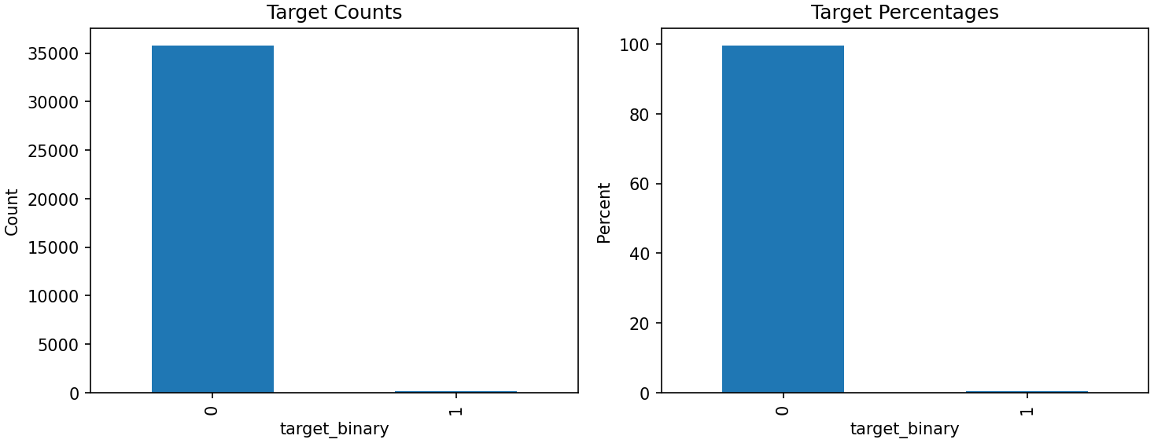
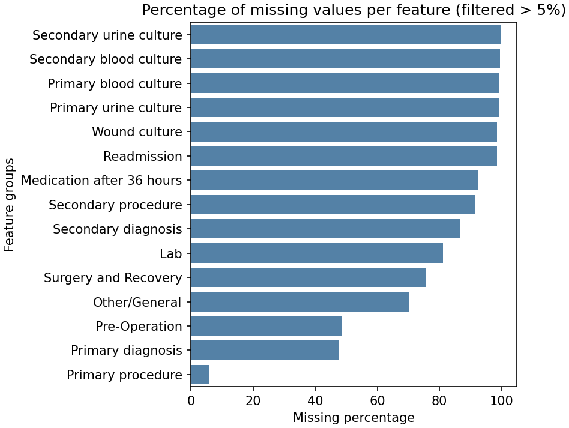
DATA
The data: Assuta Ramat HaHayal EHR
35,925
surgical events
141 · 0.39%
Positive- ≈225 : 1 imbalance
244 → 97
columns after cleaning
Figure 2 — the outcome is very rare
Figure 3 — missingness by feature group
Two modalities, one label: structured EHR fields plus Hebrew clinical narrative- positive when either of two hospital diagnosis fields is populated.
05

Slide 6
METHOD
From raw export to a risk model
Stage 1-2
Stage 3
Stage 4
Stage 5
Exploratory analysis of the raw export and of the infected subgroup
Cleaning, cohort restriction, prediction-window enforcement
EDA repeated on the cleaned dataset
Hebrew text processing: comparison of three text models
Stage 6
Stage 7
Stage 8
Feature engineering; locked train/test split: out-of-fold text score
Pre-modelling: prototype aggregation, encoding, imputation
Modelling: balancing, tuning, threshold selection, calibration, evaluation, SHAP
Key pivot-
Post-operative fields turned out to be filled in only once infection was already suspected — target leakage. The prediction point
moved back to the end of surgery.
06

Slide 7
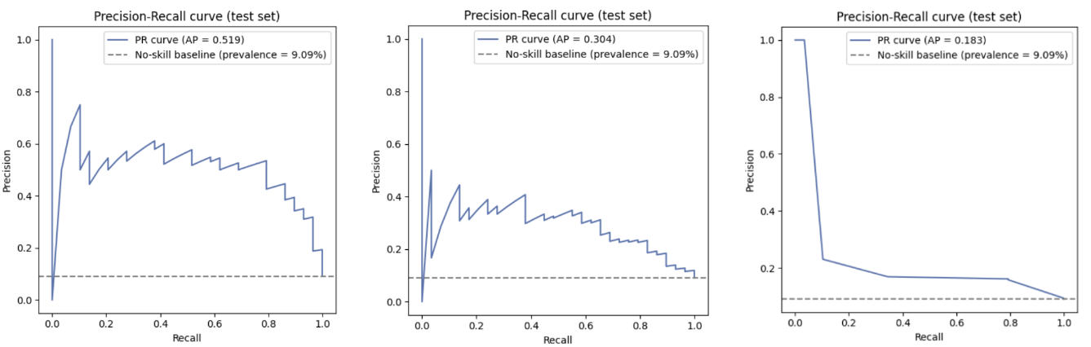
FIRST COMPARISON
Comparing the text models
Method | ROC-AUC | PR-AUC (AP) | Precision | Recall
TF-IDF + logistic regression | 0.933 | 0.519 | 0.577 | 0.517
TF-IDF + XGBoost | 0.821 | 0.304 | 0.286 | 0.069
Llama 3.3:70b, prompted | 0.701 | 0.183 | 0.169 | 0.345
Precision–recall by representation
Evaluated on a rebalanced 319-note split (29 positive, 290 negative), built to rank the three representations- not to estimate population performance.
Takeaway: the simplest model won decisively over a 70-billion-parameter LLM. TF-IDF + logistic regression became the text-derived score carried into the tabular model.
07

Slide 8
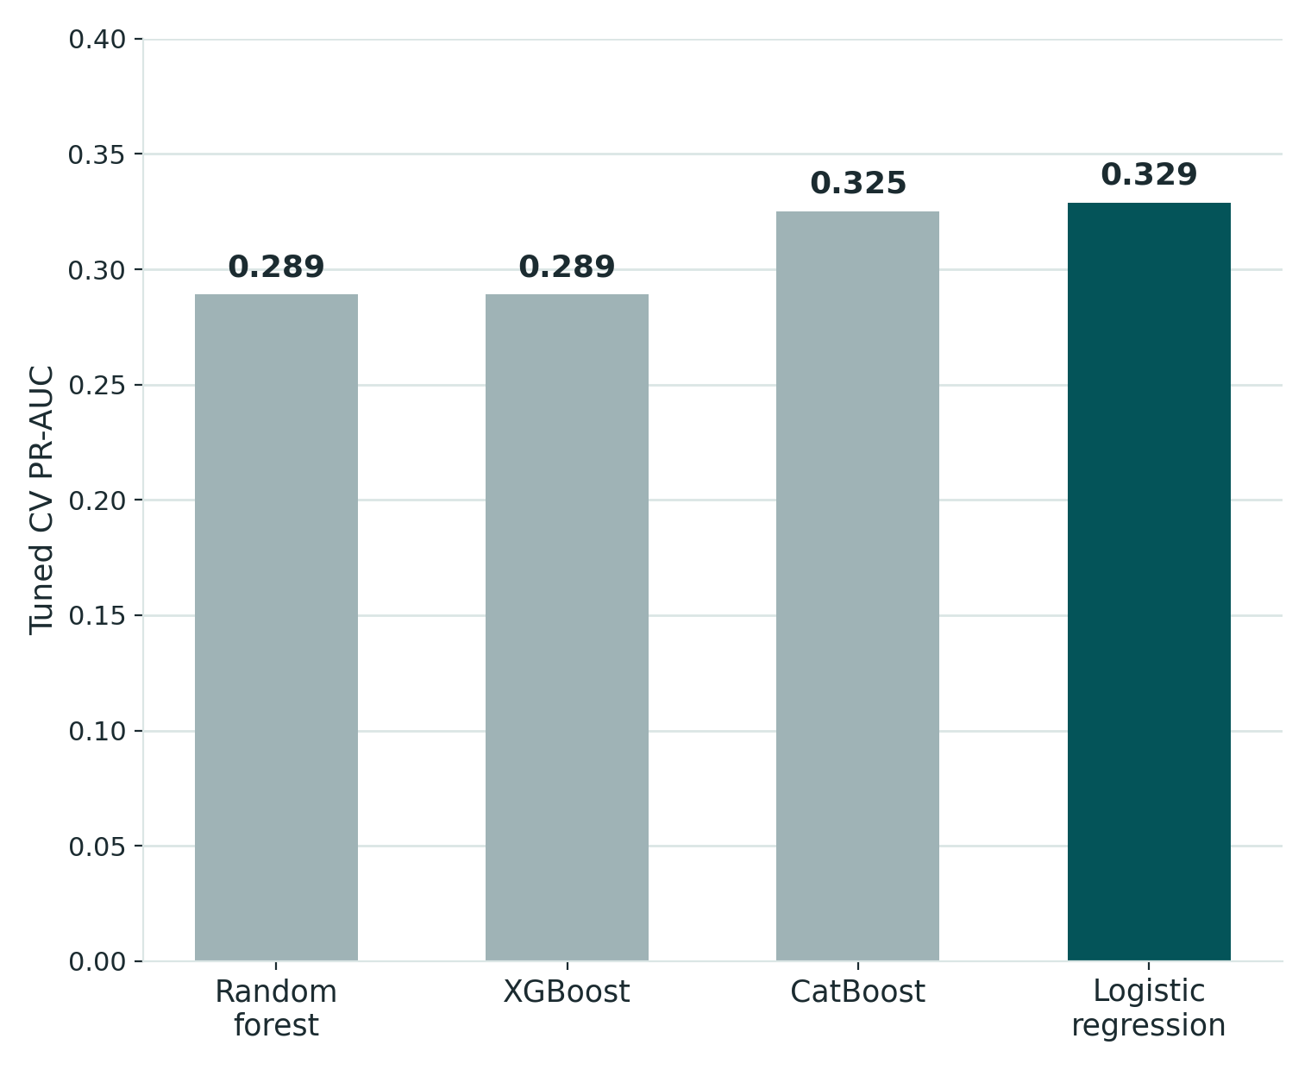
SECOND COMPARISON
Comparing the tabular models
Model | Tuned CV PR-AUC | Tuning runtime (s)
Logistic regression - locked | 0.329 | 11
CatBoost | 0.325 | 1,547
XGBoost | 0.289 | 31
Random forest | 0.289 | 86
Tuned CV PR-AUC by model
Takeaway
Logistic regression and CatBoost were a near-tie on
CV PR-AUC (0.329 vs. 0.325). The tie was resolved for the cheaper, more interpretable SMOTE-balanced linear model.
08

Slide 9
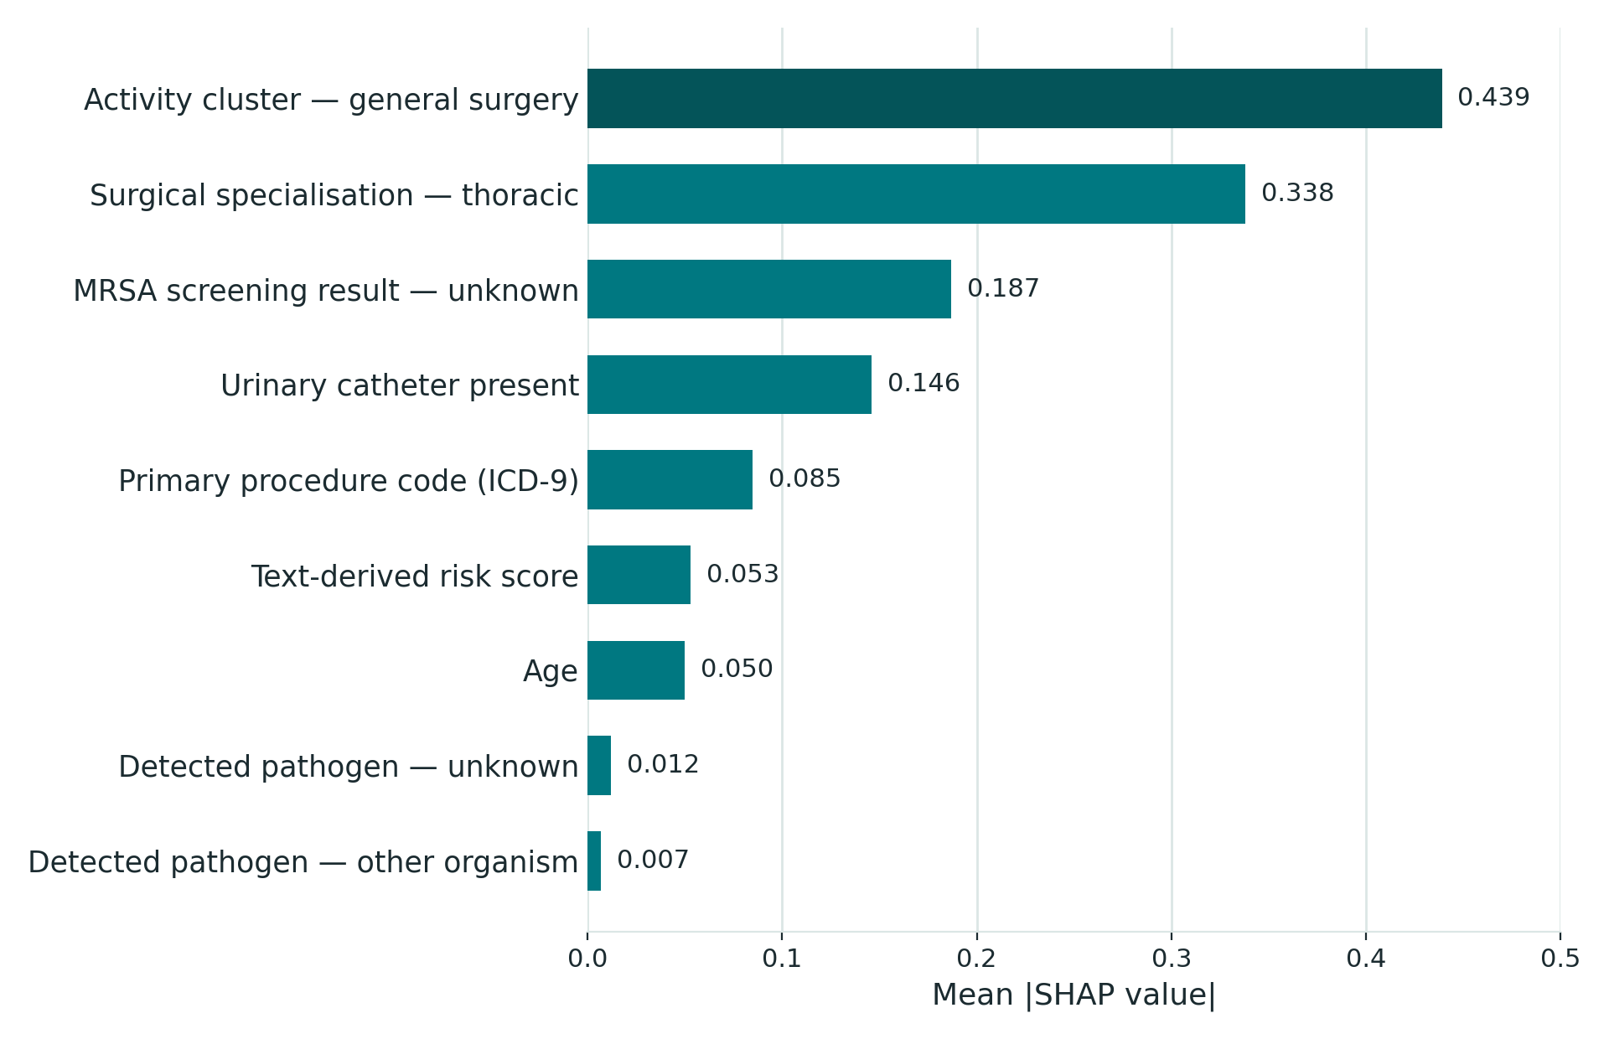
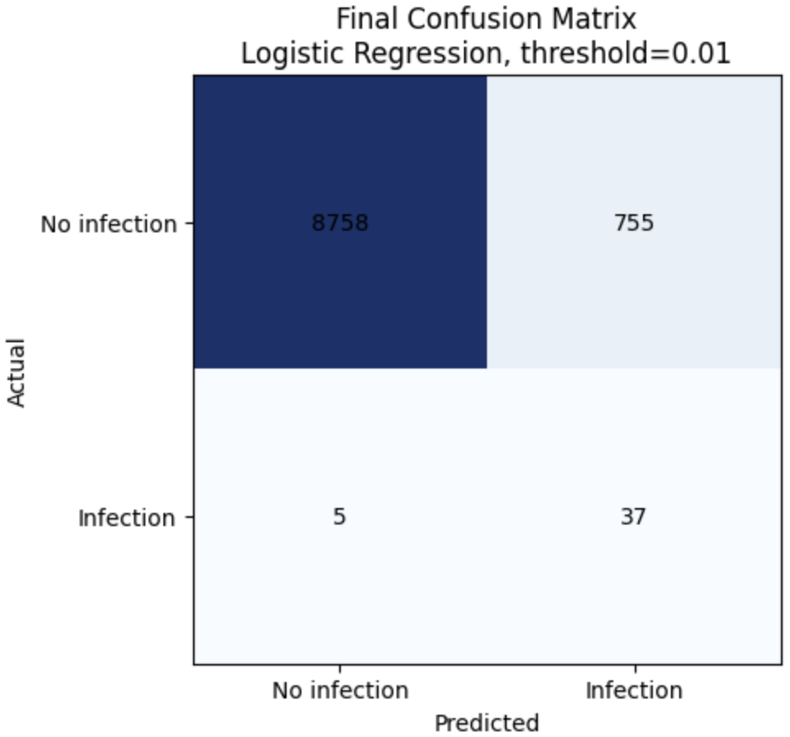
Final model performance
What drives the score (SHAP)
Confusion matrix - 9,555 events, 42 infections
Clinical workload: 82.9 alerts per 1,000 procedures.
09

Slide 10
Conclusions
1
Hebrew clinical narrative carries genuine infection
2
High discrimination does not mean high precision
3
The prediction point is a clinical decision, not a technical parameter
4
A single scalar may be too narrow a channel for multimodal integration
5
Leakage control has to be designed into the pipeline
Objectives: 4 achieved / 1 partially achieved- early identification demonstrated retrospectively, not prospectively.
10

Slide 11
READ HONESTLY
Limitations
Statistical power
A compressed feature set
A clinical convention, not a timestamp
Only 42 positive cases in the frozen test set- a shift of 3 cases moves recall by more than 7 points.
266 candidate columns were reduced to 20 before modelling- reasonable with 99 positive training cases, but a real reduction.
The top-ranked admission-screening fields are classified as pre-operative by clinical judgement- no patient-level timestamp confirms it.
A possible cohort artefact
Single centre, no external validation
Performance varies by subgroup
Four zero-infection activity clusters were excluded- plausibly genuine low risk, but partly a documentation gap.
One private medical centre; infections treated elsewhere are not captured, so labels likely under-count true infections.
AP 0.42 in general surgery vs. 0.03 in thoracic surgery- one pooled model and one threshold were still used for all.
11

Slide 12
RECOMMENDATIONS
Directions for further work
Richer text integration
Hebrew Transformer
Subgroup-specific thresholds
Beyond one scalar score
Domain-adapted, GPU-trained
Especially thoracic surgery
Prospective evaluation
Dynamic risk model
Hospital dashboard
On newly admitted patients
Continuously updating
Surface score in workflow
12

Slide 13
Thank you!
Tal Meillet & Hodaya Yasayev Klenter
B.Sc. Digital Medical Technologies, Holon Institute of Technology
Special thanks to:
Dr. Manor Shpriz- Clinical Supervisor, Assuta Ramat HaHayal
Galina- Infection Control Nurse, Assuta Ramat HaHayal
David Falka- System Team, Information Systems Division, Assuta

